Slide 1


BUILD YOUR PERSONAL AI AGENT WITH CLAUDE CODE

Slide 2

What you're building
THE BIG PICTURE
A personal AI agent OS, not a chatbot
soul.md = your voice. Vault = persistent wiki. Notion = dashboards. Obsidian = read-only graph view.
soul.md
Vault
Notion
Obsidian
Your identity, voice, priorities. Injected into every session. The agent never sounds generic.
Karpathy-pattern wiki. Pages, [[wiki links]], index, log. Compounds with every source.
10 databases under one parent page. Boards, tables, calendars. Dashboards you read on phone.
© All rights reserved for Dr. Ryan Ahmed @Stemplicity Inc.
Open the vault folder, see the graph. Cross-references light up. Search by tag or backlink.

Slide 3



The Three-Layer Architecture
soul.md
YOUR IDENTITY
How you write, what you care about, your personality. Every output sounds like you wrote it.
vault
YOUR BRAIN
An Obsidian wiki that grows with every interaction. People, meetings, projects, research.
© All rights reserved for Dr. Ryan Ahmed @Stemplicity Inc.
work
YOUR AUTOMATIONS
Each automation reads from the vault, does its job, writes back. The vault gets richer. The automations get better.

Slide 4
10 Automations. All Connected.
01
02
03
04
05
Sprint Tracker
Morning Brief
Market Pulse
Research Team
Personal CRM
Project board
Daily snapshot
Competitor radar
Multi-agent research
Relationship tracker
© All rights reserved for Dr. Ryan Ahmed @Stemplicity Inc.
06
07
08
09
10
Meeting Intel
Email Triage
Expense Wrangler
Content Machine
Weekly Exec Report
Prep & extraction
Inbox manager
Receipt processing
Multi-format content
Capstone rollup
Each automation reads from the vault, does its job, and writes back. The system compounds.

Slide 5
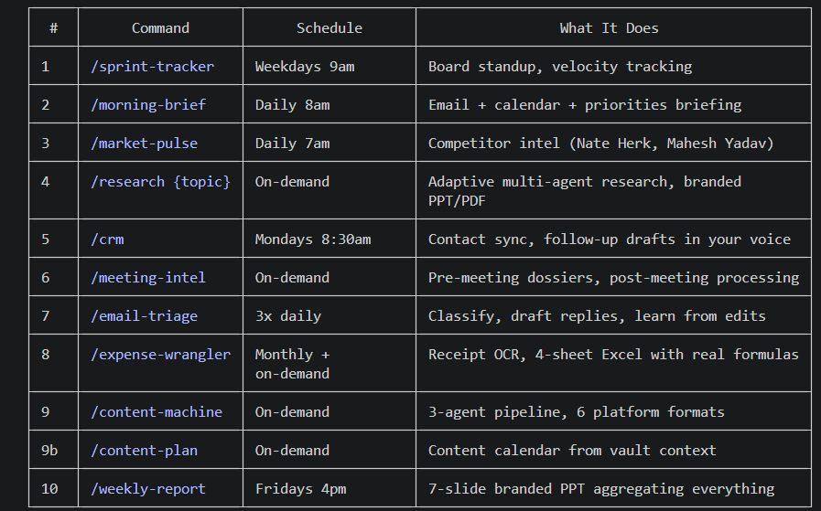
10 Automations. All Connected.
© All rights reserved for Dr. Ryan Ahmed @Stemplicity Inc.

Slide 6
RESEARCH TEAM

Slide 7
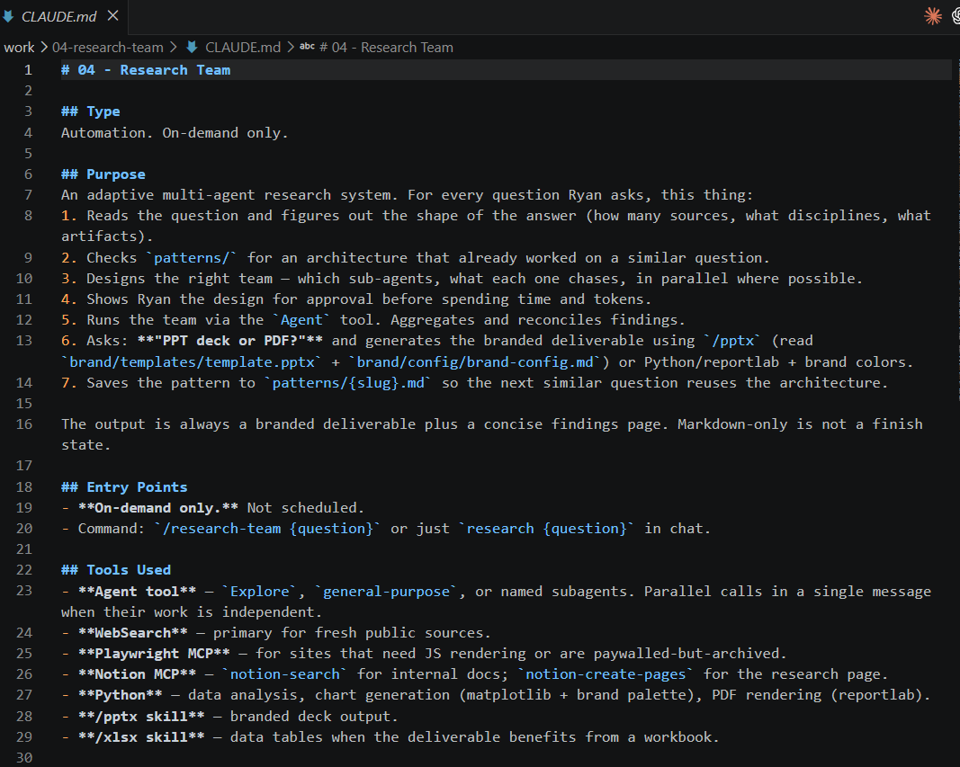
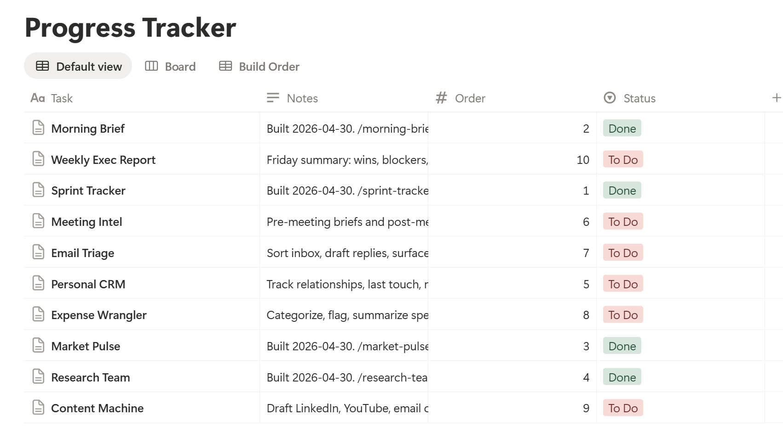
Prompt 4: Research Team
After running the research team, a Claude.md file is created under the work folder along with a new slash command.
© All rights reserved for Dr. Ryan Ahmed @Stemplicity Inc.

Slide 8
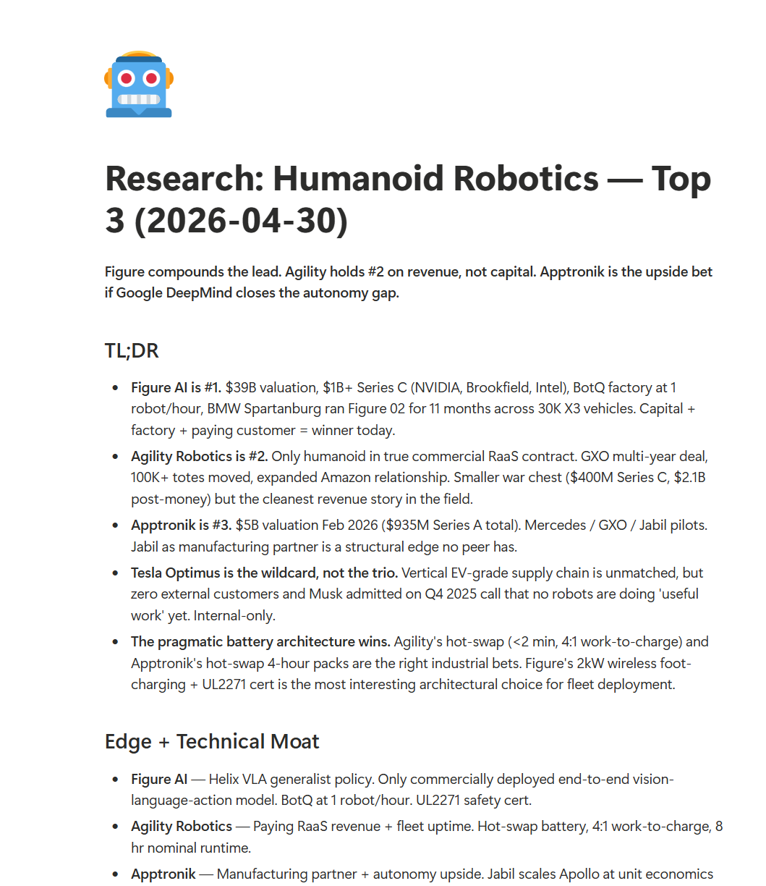
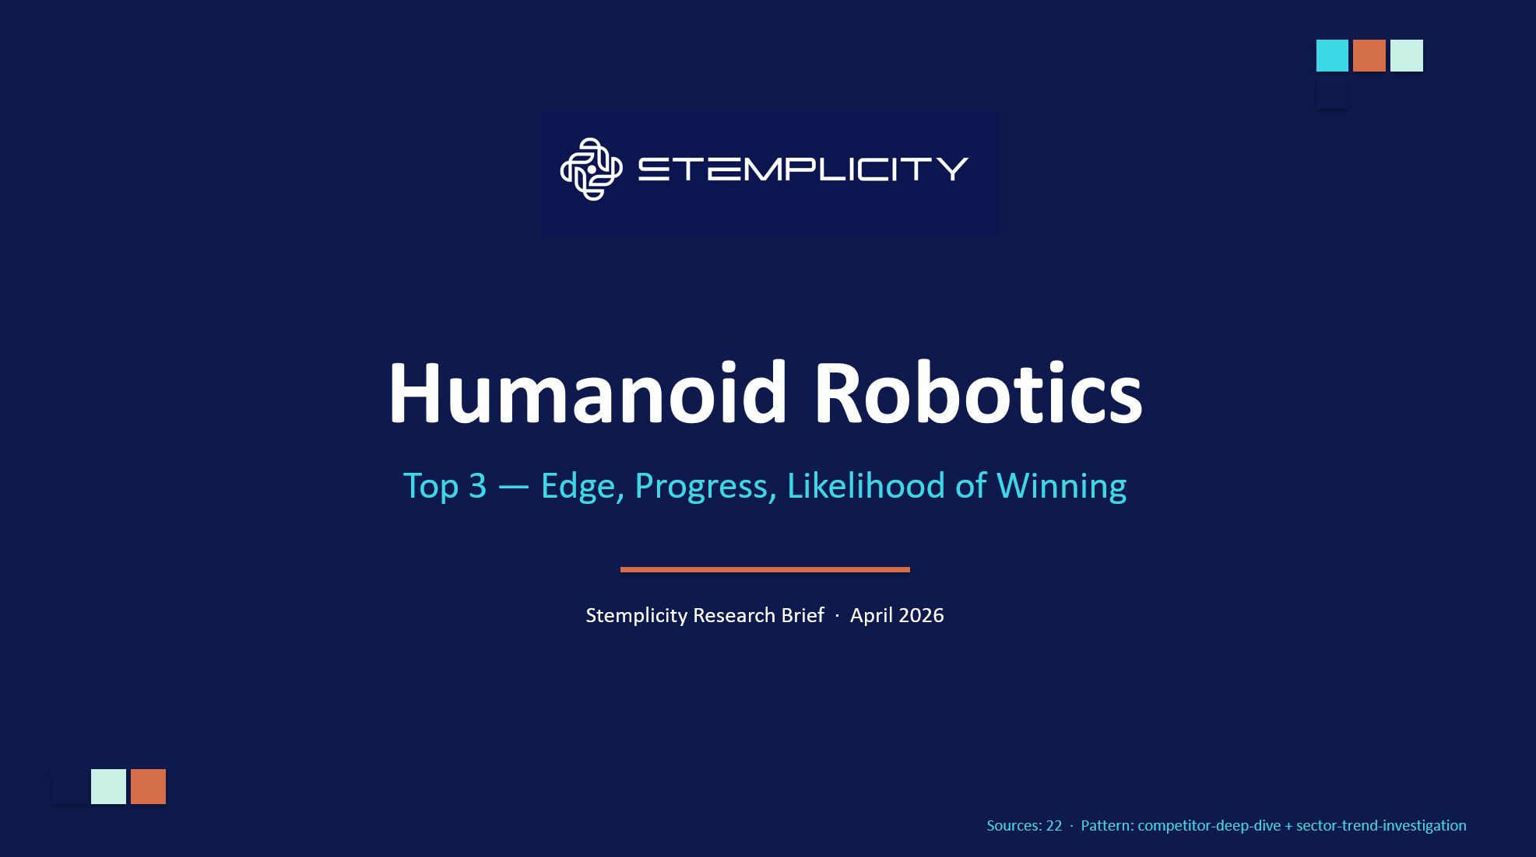
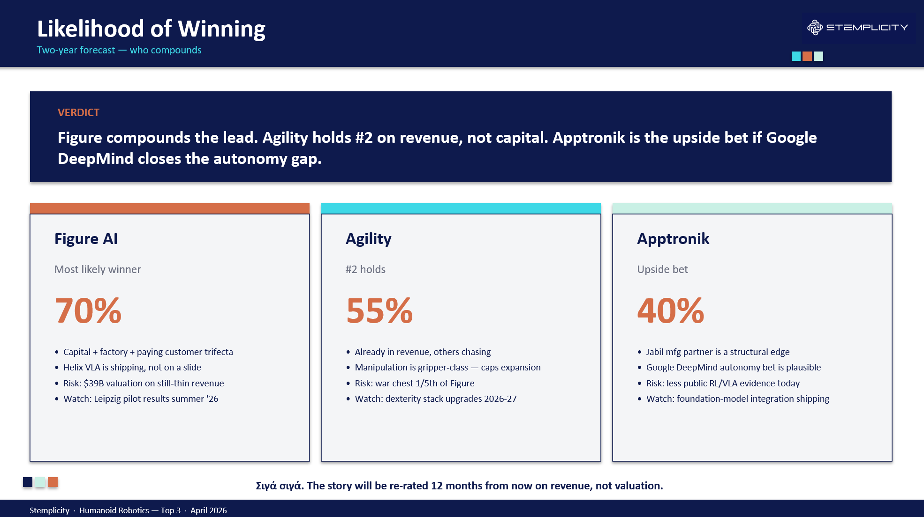
Now Let’s test the /research-team command
Now you can run the research-team command with the following prompt:
/research-team Top 3 humanoid robotics companies and provide a concise breakdown of their edge, current progress, and likelihood of winning. Generate a 5-slide Powerpoint deck using the brand color.
© All rights reserved for Dr. Ryan Ahmed @Stemplicity Inc.

Slide 9
PERSONAL CRM

Slide 10
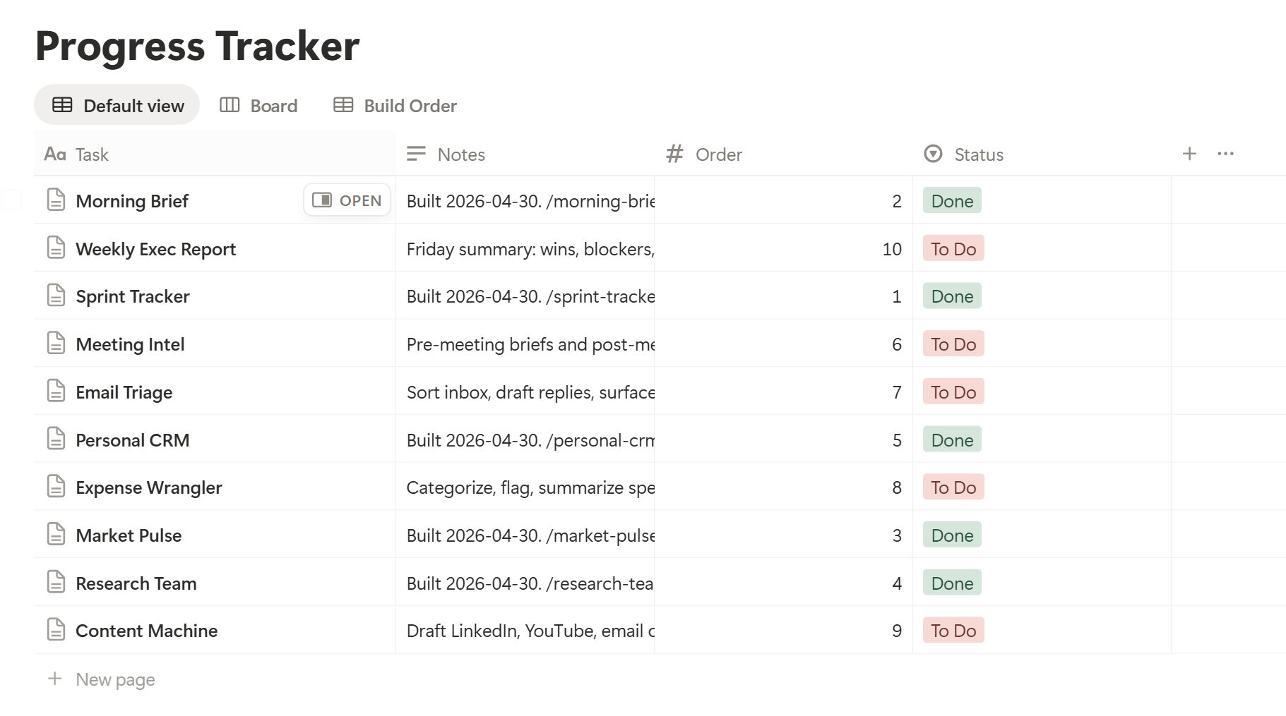
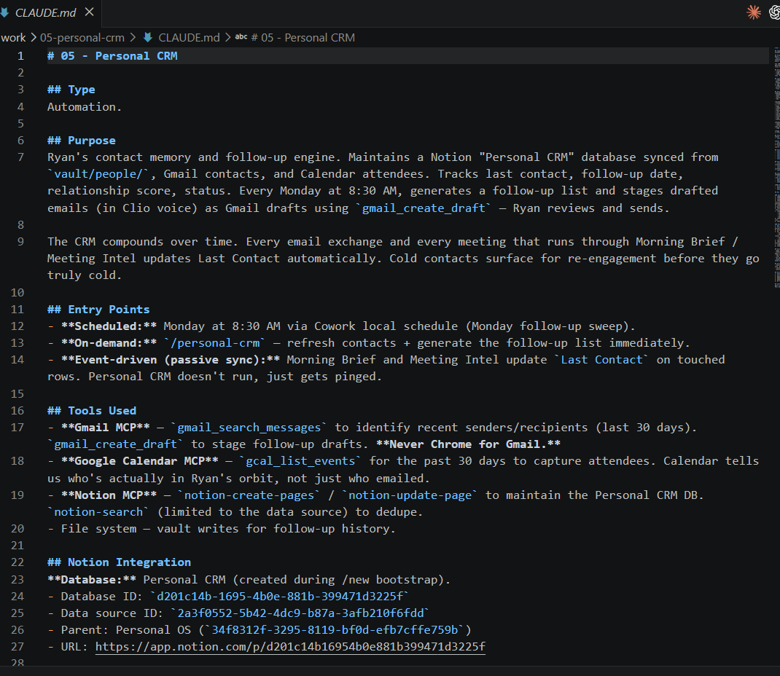
Prompt 5: Personal CRM
After running the personal CRM, a Claude.md file is created under the work folder along with a new slash command.
© All rights reserved for Dr. Ryan Ahmed @Stemplicity Inc.

Slide 11
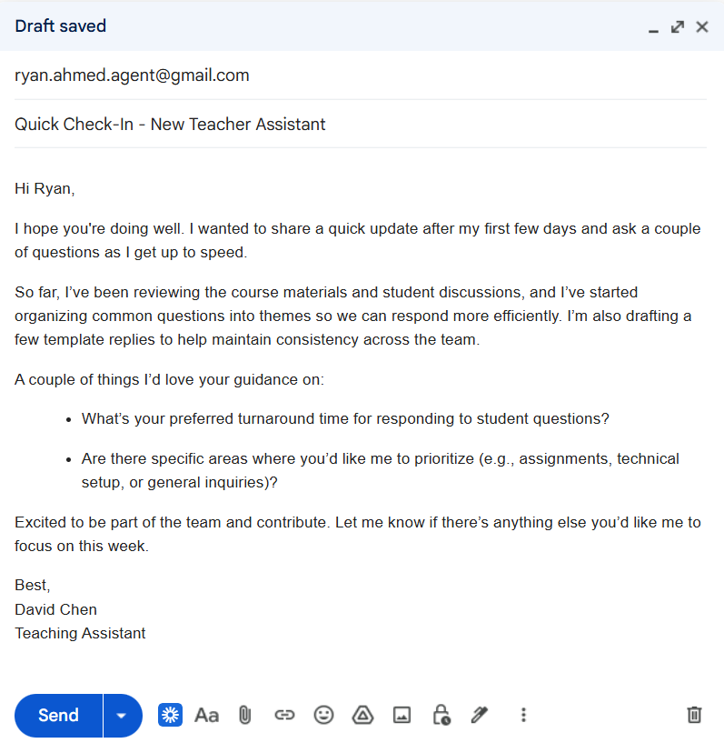
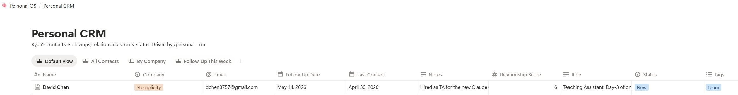
Let’s test the Personal-CRM
After running the personal CRM, a Claude.md file is created under the work folder along with a new slash command.
Assume that David Chen sent this email to me.
Now run /personal-crm
© All rights reserved for Dr. Ryan Ahmed @Stemplicity Inc.

Slide 12
MEETING INTEL

Slide 13
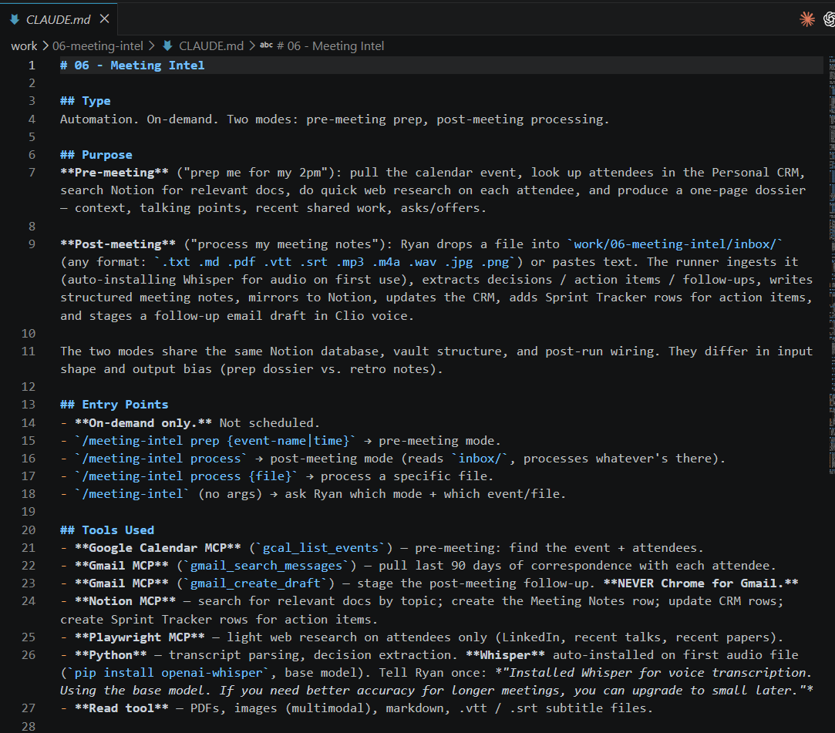
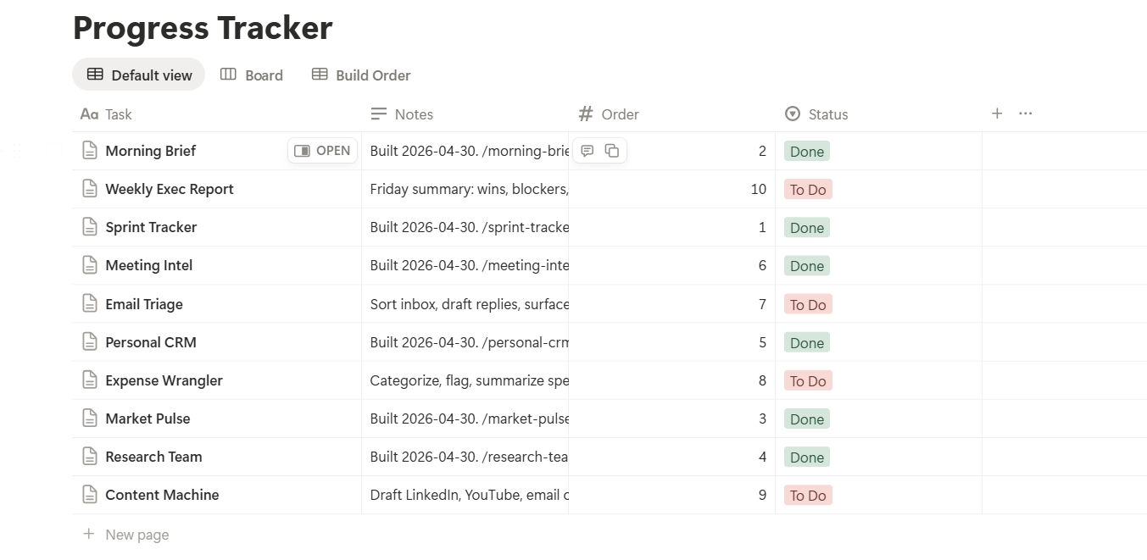
Prompt 6: Meeting Intel
After running the meeting intel, a Claude.md file is created under the work folder along with a new slash command.
© All rights reserved for Dr. Ryan Ahmed @Stemplicity Inc.

Slide 14
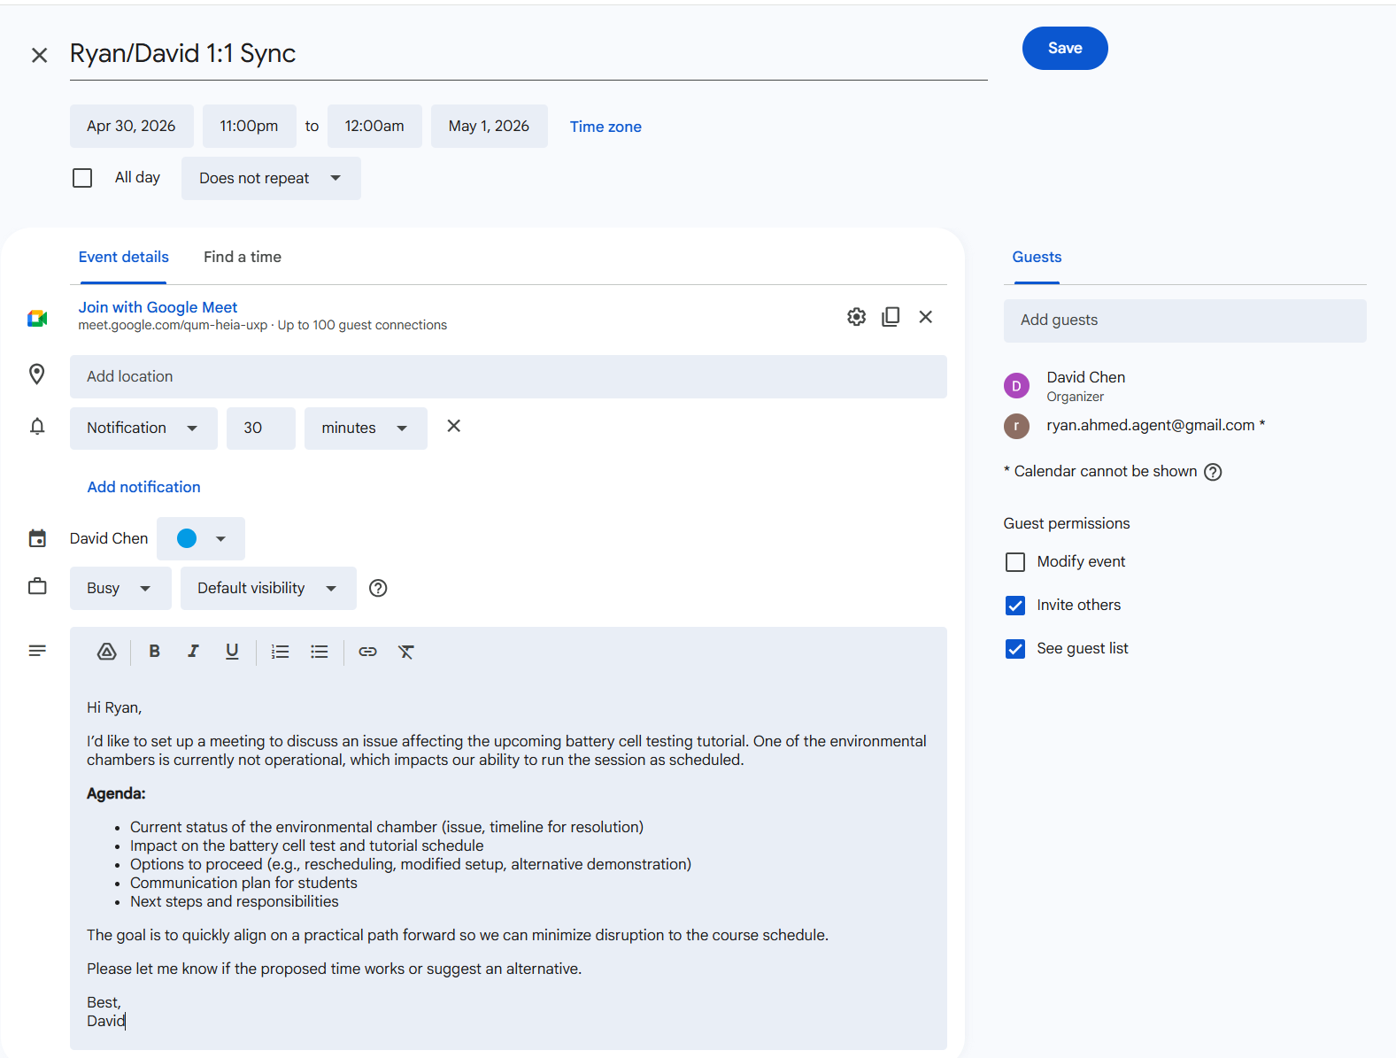
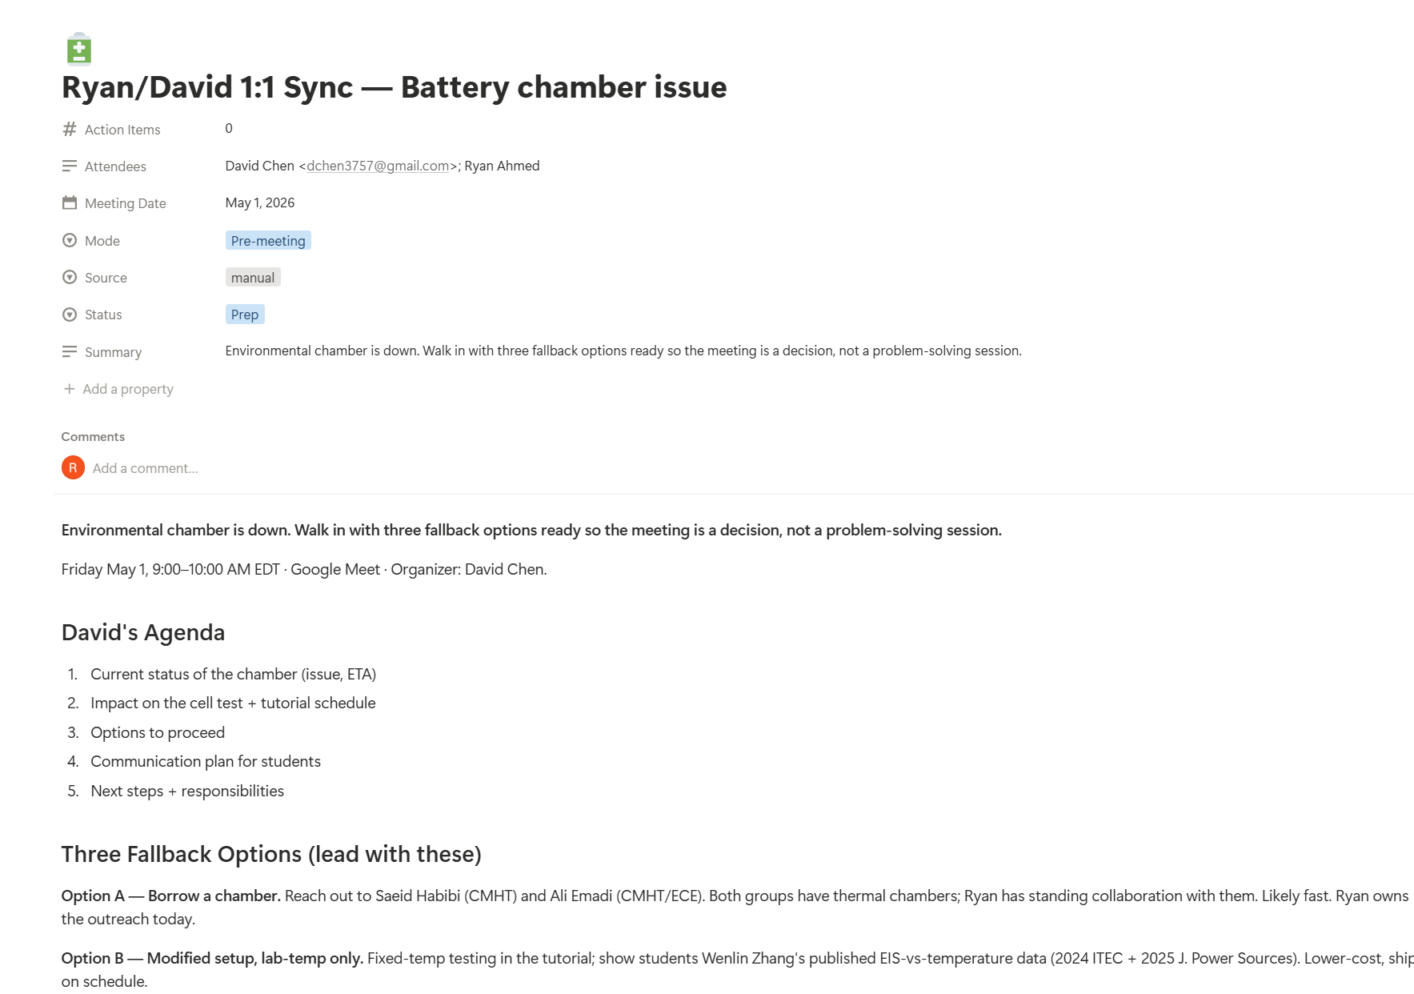
Let’s test the Meeting intelligence
Assume that you received the meeting invitation below, now run the meeting intelligence slash command.
© All rights reserved for Dr. Ryan Ahmed @Stemplicity Inc.

Slide 15
EMAIL TRIAGE

Slide 16
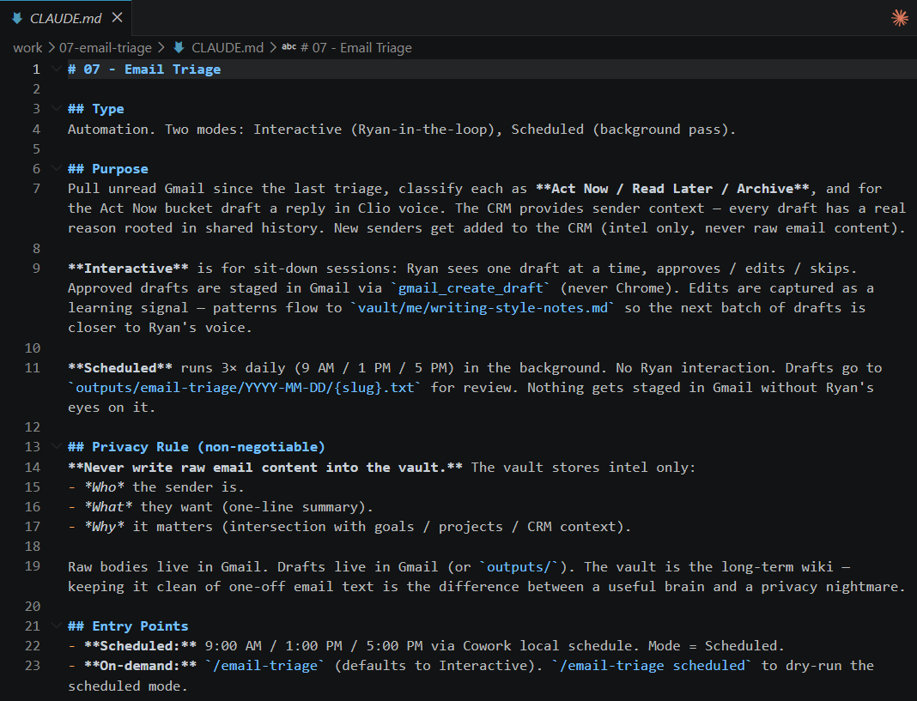
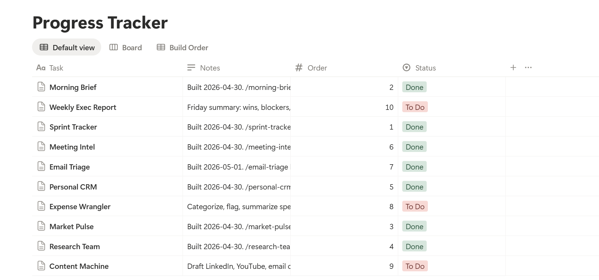
Prompt 7: Email Triage
After running the Email Triage, a Claude.md file is created under the work folder along with a new slash command.
© All rights reserved for Dr. Ryan Ahmed @Stemplicity Inc.

Slide 17
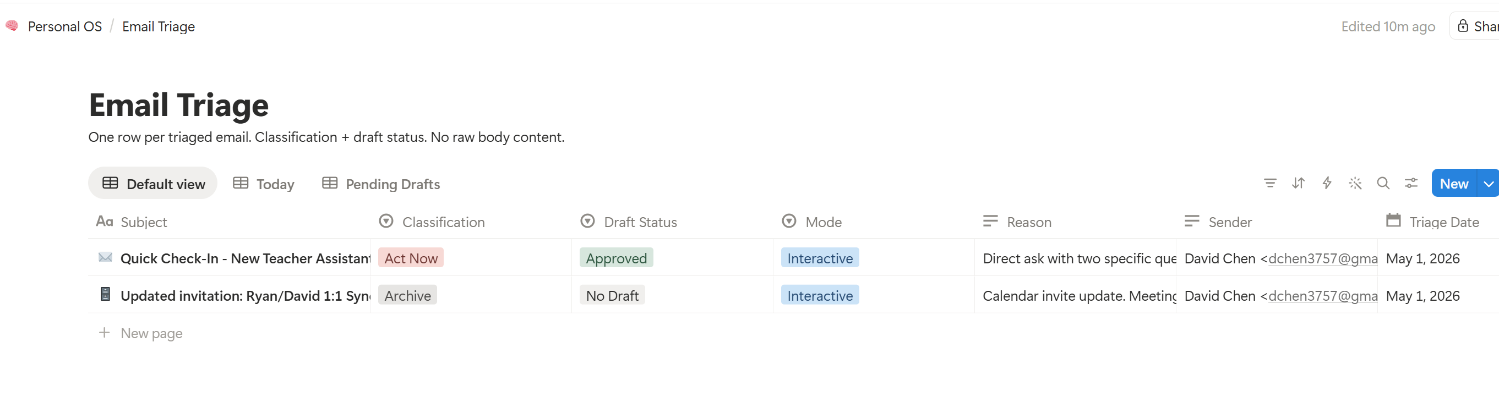
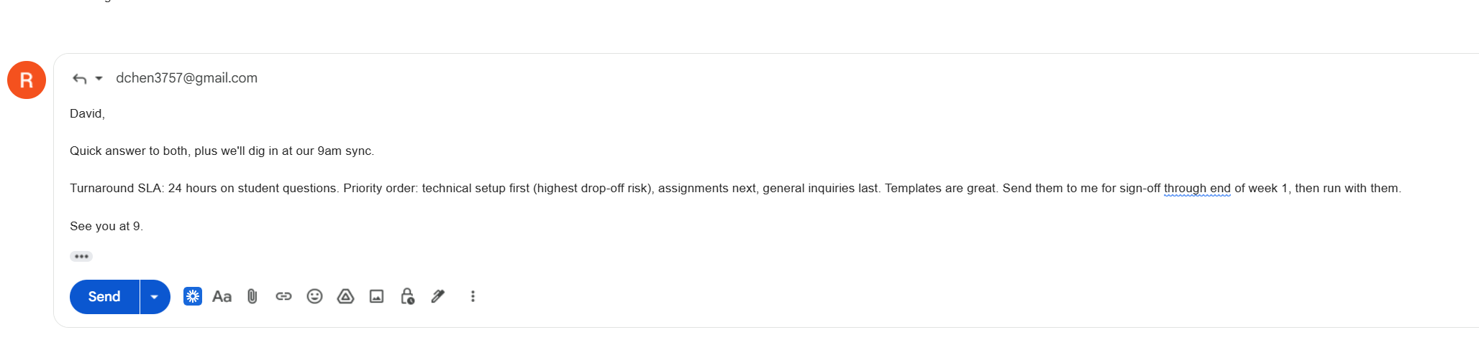
Let’s run the email triage
A draft email will be written as shown below.
© All rights reserved for Dr. Ryan Ahmed @Stemplicity Inc.

Slide 18
Thank you!

